Slide 1
Socket Programming

Slide 2








Recap: Client-Server Communication Paradigm
Typical network app has two pieces: client and server
application
transport
network
data link
physical
Client:
initiates contact with server (“speaks first”)
typically requests service from server
request
reply
Server:
provides requested service to client
application
transport
network
data link
physical

Slide 3
Client/server model
Client asks (request) – server provides (response)
Typically: single server - multiple clients
The server does not need to know anything about the client
  even that it exists
The client should always know something about the server
  at least where it is located
1. Client sends request
Client
process
Server
process
Resource
4. Client
handles
response
3. Server sends response
2. Server
handles
request
Note: clients and servers are processes running on hosts
(can be the same or different hosts).
Notes:
Both Can run on the same machine

Slide 4
Internet Connections (TCP/IP)
Address the machine on the network
  By IP address
Address the process
  By the “port”-number
The pair of IP-address + port – makes up a “socket-address”
Client socket address
128.2.194.242:3479
Server socket address
208.216.181.15:80
Client
Server
(port 80)
Connection socket pair
(128.2.194.242:3479, 208.216.181.15:80)
Client host address
128.2.194.242
Server host address
208.216.181.15
Note: 3479 is an
ephemeral port allocated
by the kernel
Note: 80 is a well-known port
associated with Web servers

Slide 5
Clients
Examples of client programs
  Web browsers, ftp, telnet, ssh
How does a client find the server?
  The IP address in the server socket address identifies the host
  The (well-known) port in the server socket address identifies the service, and thus implicitly identifies the server process that performs that service.
  Examples of well known ports
    Port 7: Echo server
    Port 23: Telnet server
    Port 25: Mail server
    Port 80: Web server

Slide 6
Using Ports to Identify Services
Server host 128.2.194.242
Client host
Service request for
128.2.194.242:80
(i.e., the Web server)
Web server
(port 80)
Client
Kernel
Echo server
(port 7)
Service request for
128.2.194.242:7
(i.e., the echo server)
Web server
(port 80)
Client
Kernel
Echo server
(port 7)

Slide 7
Servers
Servers are long-running processes (daemons).
  Created at boot-time (typically) by the init process (process 1)
  Run continuously until the machine is turned off.
Each server waits for requests to arrive on a well-known port associated with a particular service.
  Port 7: echo server
  Port 23: telnet server
  Port 25: mail server
  Port 80: HTTP server
Other applications should choose between 1024 and 65535
See /etc/services for a comprehensive list of the services available on a Linux machine.

Slide 8
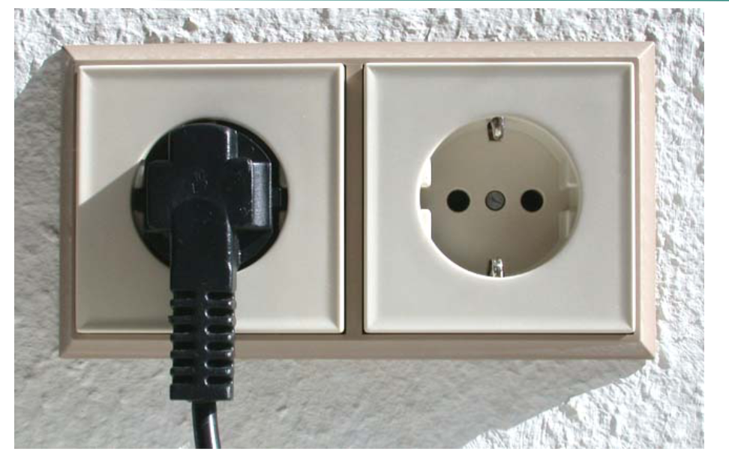
Sockets!

Slide 9
What are sockets?
Abstract representation of a network connection on application level
  Corresponding API provided by the host’s OS
  OS responsible for actual data transmission
  Application responsible for content
Makes sending data to a connected remote host similar to simply writing data to a file
  Receiving data is similar to reading from a file

Slide 10

Sockets as means for inter-process communication (IPC)
application layer
application layer
Client Process
Internet
Server Process
Socket
Socket
OS network
stack
OS network
stack
transport layer (TCP/UDP)
transport layer (TCP/UDP)
Internet
network layer (IP)
network layer (IP)
link layer (e.g. ethernet)
link layer (e.g. ethernet)
Internet
physical layer
physical layer
The interface that the OS provides to its networking subsystem

Slide 11
How do Sockets releate to Applications?
Browsers, Webservers
Mailservers, Mailclients
Peer 2 Peer Apps
Use sockets to speak HTTP
Use sockets to speak SMTP/IMAP/POP3
Use sockets to speak, e.g., Bittorrent

Slide 12

Socket programming
Goal: learn how to build client/server applications that communicate using sockets
Socket: door between application process and end-end-transport protocol
application
socket
application
controlled by
app developer
process
process
transport
transport
network
network
controlled
by OS
link
Internet
link
physical
physical

Slide 13
Socket Programming: Basics
The server application must be running before the client can send anything.
The server must have a socket through which it sends and receives messages. The client also need a socket.
Locally, a socket is identified by a port number.
In order to send messages to the server, the client needs to know the IP address and the port number of the server.
Port number is analogous to an apartment number. All doors (sockets) lead into the building, but the client only has access to one of them, located at the provided number.

Slide 14
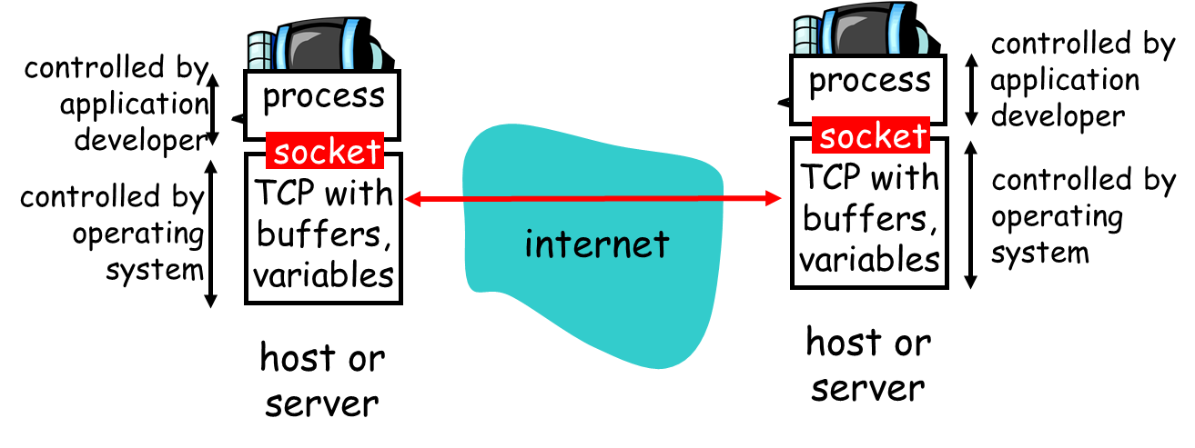
Socket Programming: Analogy
Socket:
Interface between the application layer and the transport layer within a host
Analogous to a door:
  The sending process which is created in an application, shoves the messages out of the “door”

Slide 15
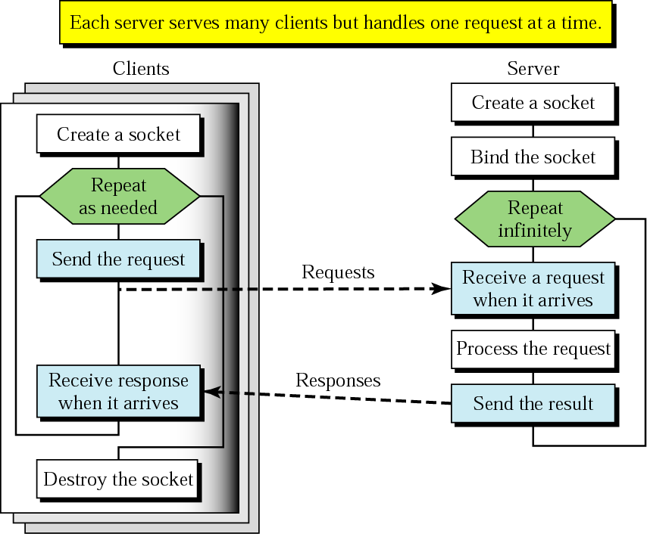
Client+server: connectionless
CREATE
BIND
SEND
RECEIVE
SEND
CLOSE

Slide 16
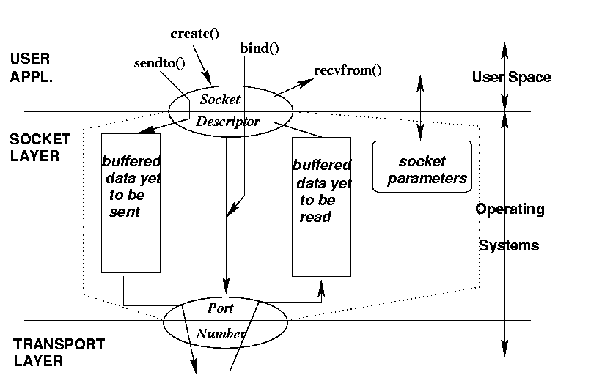
Socket: conceptual view
socket()

Slide 17
Socket programming
Two socket types for two transport services:
  UDP: unreliable datagram
  TCP: reliable, byte stream-oriented
  Application Example:
client reads a line of characters (data) from its keyboard and sends data to server
server receives the data and converts characters to uppercase
server sends modified data to client
client receives modified data and displays line on its screen

Slide 18
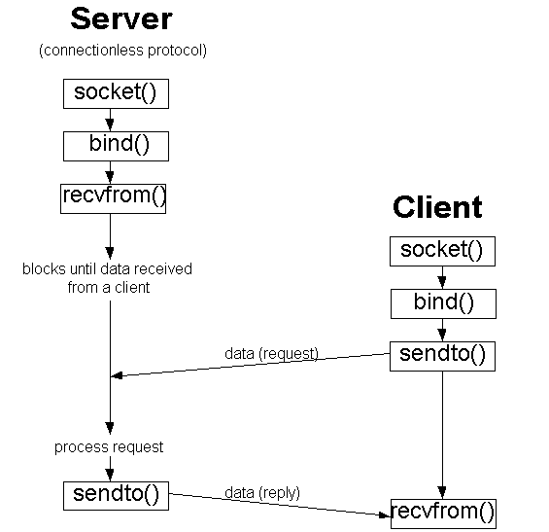
BSD Socket Programming (connectionless)

Slide 19
Socket programming with UDP
UDP: transmitted data may be lost or received out-of-order
Application viewpoint:
UDP provides unreliable transfer of groups of bytes (“datagrams”) between client and server processes

Slide 20
Client/server socket interaction: UDP
server (running on serverIP)
client
create socket:
create socket, port= x:
clientSocket =
socket(AF_INET,SOCK_DGRAM)
serverSocket =
socket(AF_INET,SOCK_DGRAM)
Create datagram with server IP and
port=x; send datagram via
clientSocket
read datagram from
serverSocket
write reply to
serverSocket
specifying
client address,
port number
read datagram from
clientSocket
close
clientSocket

Slide 21
Example app: UDP server
Python UDPServer
include Python’s socket
library
from socket import *
serverPort = 12000
serverSocket = socket(AF_INET, SOCK_DGRAM)
serverSocket.bind(('', serverPort))
print (“The server is ready to receive”)
while True:
message, clientAddress = serverSocket.recvfrom(2048)
modifiedMessage = message.decode().upper()
serverSocket.sendto(modifiedMessage.encode(),
clientAddress)
create UDP socket
bind socket to local port number 12000
Buffer size
Read from UDP socket into message, getting client’s address (client IP and port)
send upper case string back to this client

Slide 22
host
host can be a hostname, IP address, or empty string.
If an IP address is used, host should be an IPv4-formatted address string.
The IP address 127.0.0.1 is the standard IPv4 address for the loopback interface, so only processes on the host will be able to connect to the server.
If you pass an empty string, the server will accept connections on all available IPv4 interfaces.

Slide 23
serverSocket.bind((’’, serverPort))
The above line binds (that is, assigns) the port number 12000 to the server’s socket.
In UDPServer, the code (written by the application developer) is explicitly assigning a port number to the socket.
When anyone sends a packet to port 12000 at the IP address of the server, that packet will be directed to this socket.
UDPServer then enters a while loop; the while loop will allow UDPServer to receive and process packets from clients indefinitely.

Slide 24
message, clientAddress = serverSocket.recvfrom(2048)
This line of code is similar to what we saw in UDPClient. When a packet arrives at the server’s socket, the packet’s data is put into the variable message and the packet’s source address is put into the variable clientAddress.
The variable clientAddress contains both the client’s IP address and the client’s port number.
Here, UDPServer will make use of this address information, as it provides a return address, similar to the return address with ordinary postal mail. With this source address information, the server now knows to where it should direct its reply.

Slide 25
modifiedMessage = message.decode().upper()
This line is the heart of our simple application. It takes the line sent by the client and, after converting the message to a string, uses the method upper() to capitalize it.

Slide 26
serverSocket.sendto(modifiedMessage.encode(), clientAddress)
This last line attaches the client’s address (IP address and port number) to the capitalized message (after converting the string to bytes), and sends the resulting packet into the server’s socket.
The server address is also attached to the packet, although this is done automatically rather than explicitly by the code
The Internet will then deliver the packet to this client address.
After the server sends the packet, it remains in the while loop, waiting for another UDP packet to arrive (from any client running on any host).

Slide 27
Example app: UDP client
Python UDPClient
include Python’s socket
library
from socket import *
serverHost = ‘127.0.0.1’
serverPort = 12000
clientSocket = socket(AF_INET,
SOCK_DGRAM)
message = input(’Input lowercase sentence:’)
clientSocket.sendto(message.encode(),
(serverHost, serverPort))
modifiedMessage, serverAddress =
clientSocket.recvfrom(2048)
print(modifiedMessage.decode())
clientSocket.close()
create UDP socket for server
get user keyboard
input
Attach server name, port to message; send into socket
Buffer size
read reply characters from
socket into string
print out received string and close socket

Slide 28
from socket import *
The socket module forms the basis of all network communications in Python.
By including this line, we will be able to create sockets within our program.

Slide 29
clientSocket = socket(AF_INET, SOCK_DGRAM)
This line creates the client’s socket, called clientSocket.
The first parameter indicates the address family; in particular, AF_INET indicates that the underlying network is using IPv4.
The second parameter indicates that the socket is of type SOCK_DGRAM, which means it is a UDP socket (rather than a TCP socket).
Note that we are not specifying the port number of the client socket when we create it; we are instead letting the operating system do this for us.
Now that the client process’s door has been created, we will want to create a message to send through the door.

Slide 30
message = input(’Input lowercase sentence:’)
input() is a built-in function in Python. When this command is executed, the user at the client is prompted with the words “Input lowercase sentence:”
The user then uses her keyboard to input a line, which is put into the variable message.
Now that we have a socket and a message, we will want to send the message through the socket to the destination host.

Slide 31
clientSocket.sendto(message.encode(), (serverHost, serverPort))
In the above line, we first convert the message from string type to byte type, as we need to send bytes into a socket; this is done with the encode() method.
The method sendto() attaches the destination address (serverHost, serverPort) to the message and sends the resulting packet into the process’s socket, clientSocket.
The source address is also attached to the packet, although this is done automatically rather than explicitly by the code

Slide 32
modifiedMessage, serverAddress = clientSocket.recvfrom(2048)
when a packet arrives from the Internet at the client’s socket, the packet’s data is put into the variable modifiedMessage and the packet’s source address is put into the variable serverAddress.
The variable serverAddress contains both the server’s IP address and the server’s port number.
The program UDPClient doesn’t actually need this server address information, since it already knows the server address from the outset; but this line of Python provides the server address nevertheless.
The method recvfrom also takes the buffer size 2048 as input. (This buffer size works for most purposes.)

Slide 33
print(modifiedMessage.decode())
This line prints out modifiedMessage on the user’s display, after converting the mes sage from bytes to string. It should be the original line that the user typed, but now capitalized.

Slide 34
clientSocket.close()
This line closes the socket. The process then terminates.

Slide 35
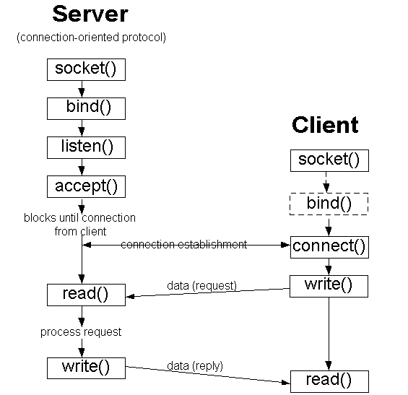
BSD Socket Programming Flows (connection-oriented)

Slide 36
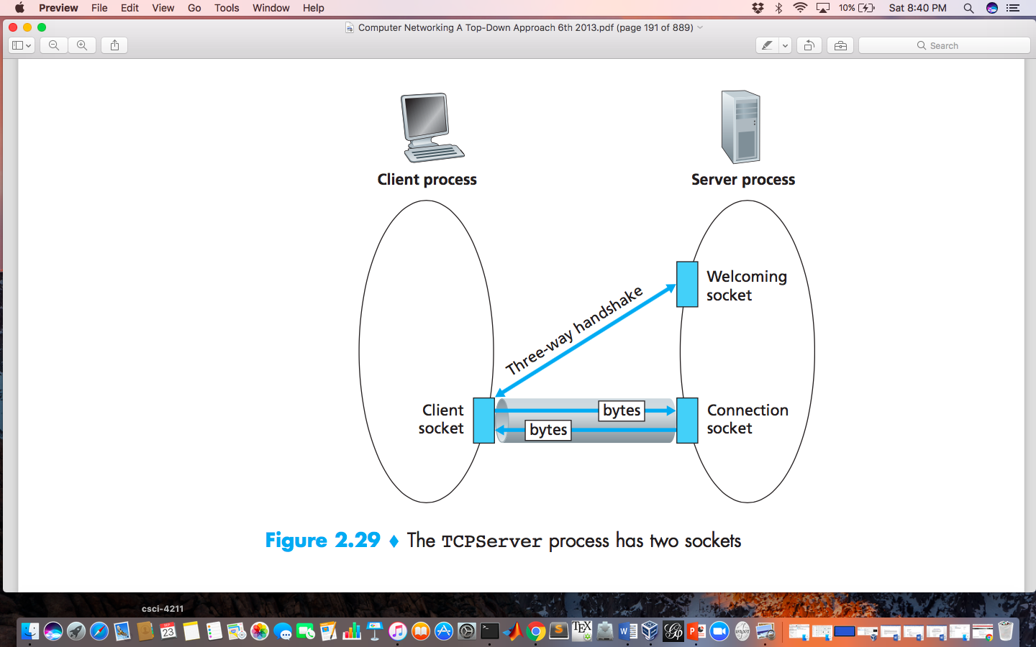
Socket programming with TCP
client must contact server
server process must first be running
server must have created socket (door) that welcomes client’s contact
client contacts server by:
Creating TCP socket, specifying IP address, port number of server process
when client creates socket: client TCP establishes connection to server TCP

Slide 37
Socket programming with TCP
when contacted by client, server TCP creates new socket for server process to communicate with that particular client
  allows server to talk with multiple clients
  source port numbers used to distinguish
application viewpoint:
TCP provides reliable, in-order
byte-stream transfer (“pipe”)
between client and server

Slide 38
Client/server socket interaction: TCP
server (running on hostid)
client
create socket,
port=x, for incoming request:
serverSocket = socket()
wait for incoming
connection request
TCP
connection setup
create socket,
connect to hostid, port=x
connectionSocket =
serverSocket.accept()
clientSocket = socket()
send request using
clientSocket
read request from
connectionSocket
write reply to
connectionSocket
read reply from
clientSocket
close
connectionSocket
close
clientSocket

Slide 39
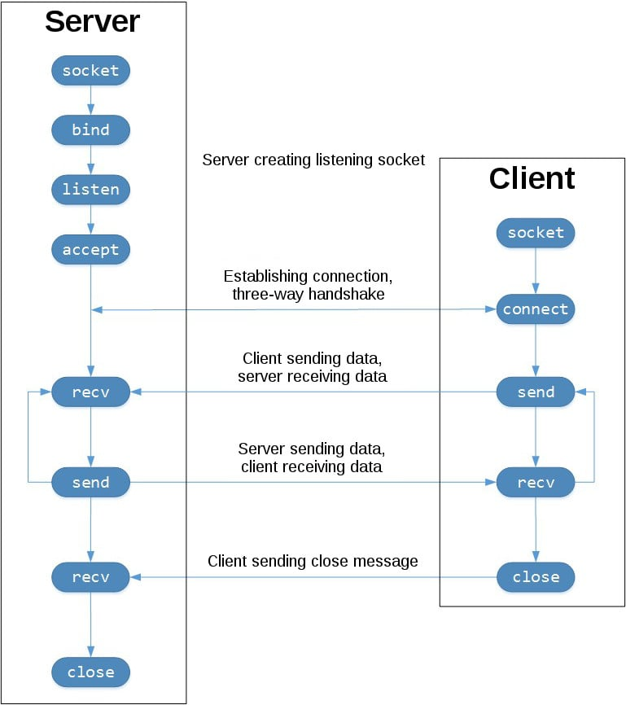

Slide 40
Example app: TCP server
Python TCPServer
from socket import *
serverPort = 12000
serverSocket = socket(AF_INET,SOCK_STREAM)
serverSocket.bind((‘’,serverPort))
serverSocket.listen(1)
print(‘The server is ready to receive’)
while True:
connectionSocket, addr = serverSocket.accept()
sentence = connectionSocket.recv(1024).decode()
capitalizedSentence = sentence.upper()
connectionSocket.send(capitalizedSentence.
encode())
connectionSocket.close()
create TCP welcoming
socket
server begins listening for incoming TCP requests
server waits on accept()
for incoming requests, new socket created on return
read bytes from socket
close connection to this client (but not welcoming socket)

Slide 41
serverSocket=socket(AF_INET,SOCK_STREAM)
As with TCPClient, the server creates a TCP socket with the above line
Similar to UDPServer, we associate the server port number, serverPort, with this socket.
But with TCP, serverSocket will be our welcoming socket.

Slide 42
serverSocket.listen(1)
After establishing this welcoming door, we will wait and listen for some client to knock on the door.
This line has the server listen for TCP connection requests from the client. The parameter specifies the maximum number of queued connections (at least 1).

Slide 43
connectionSocket, addr = serverSocket.accept()
When a client knocks on this door, the program invokes the accept() method for serverSocket, which creates a new socket in the server, called connectionSocket, dedicated to this particular client.
The client and server then complete the hand shaking, creating a TCP connection between the client’s clientSocket and the server’s connectionSocket.
With the TCP connection established, the client and server can now send bytes to each other over the connection.
With TCP, all bytes sent from one side are only guaranteed to arrive at the other side but also guaranteed to arrive in order.

Slide 44
connectionSocket.close()
In this program, after sending the modified sentence to the client, we close the connection socket.
But since serverSocket remains open, another client can now knock on the door and send the server a sentence to modify.

Slide 45
Example app: TCP client
Python TCPClient
from socket import *
serverName = ’servername’
serverPort = 12000
clientSocket = socket(AF_INET, SOCK_STREAM)
clientSocket.connect((serverName,serverPort))
sentence = input(‘Input lowercase sentence:’)
clientSocket.send(sentence.encode())
modifiedSentence = clientSocket.recv(1024)
print(‘From Server:’, modifiedSentence.decode())
clientSocket.close()
create TCP socket for server, remote port 12000
No need to attach server name, port

Slide 46
clientSocket = socket(AF_INET, SOCK_STREAM)
This line creates the client’s socket, called clientSocket. The first parameter again indicates that the underlying network is using IPv4.
The second parameter indicates that the socket is of type SOCK_STREAM, which means it is a TCP socket (rather than a UDP socket).
Note that we are again not specifying the port number of the client socket when we create it; we are instead letting the operating system do this for us.

Slide 47
clientSocket.connect((serverName,serverPort))
This line of code is very different from what we saw in UDPClient.
Recall that before the client can send data to the server (or vice versa) using a TCP socket, a TCP connection must first be established between the client and server.
The above line initiates the TCP connection between the client and server.
The parameter of the connect() method is the address of the server side of the connection.
After this line of code is executed, the three-way handshake is performed and a TCP connection is established between the client and server.

Slide 48
sentence = input(’Input lowercase sentence:’)
As with UDPClient, the above obtains a sentence from the user. The string sentence continues to gather characters until the user ends the line by typing a carriage return.

Slide 49
clientSocket.send(sentence.encode())
The above line sends the sentence through the client’s socket and into the TCP connection.
Note that the program does not explicitly create a packet and attach the destination address to the packet, as was the case with UDP sockets.
Instead the client program simply drops the bytes in the string sentence into the TCP connection.
The client then waits to receive bytes from the server.

Slide 50
modifiedSentence = clientSocket.recv(2048)
When characters arrive from the server, they get placed into the string modifiedSentence.
Characters continue to accumulate in modifiedSentence until the line ends with a carriage return character.

Slide 51
clientSocket.close()
This last line closes the socket and, hence, closes the TCP connection between the client and the server.

Slide 52
Two Different Server Behaviors
Iterative server
  At any time, only handles one client request
Concurrent server
  Multiple client requests can be handled simultaneously
  create a new process/thread to handle each request
for (;;) {
accept a client request;
handle it
}
for (;;) {
accept a client request;
create a new process / thread to handle request;
parent process / thread continues
}

Slide 53
socket.socket()
socket.socket() creates a socket object that supports the context manager type, so you can use it in a with statement. There’s no need to call s.close()
The arguments passed to socket() are constants used to specify the address family and socket type.
AF_INET is the Internet address family for IPv4. SOCK_STREAM is the socket type for TCP, the protocol that will be used to transport messages in the network.

Slide 54
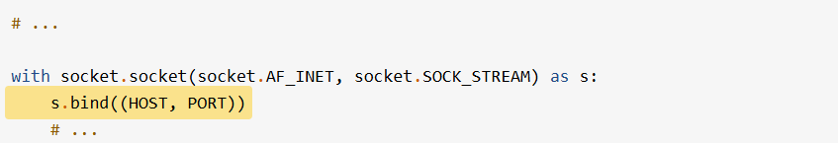
.bind()
The .bind() method is used to associate the socket with a specific network interface and port number:
The values passed to .bind() depend on the address family of the socket.
In this example, we’re using socket.AF_INET (IPv4). So it expects a two-tuple: (host, port).

Slide 55
port
port represents the TCP port number to accept connections on from clients.
It should be an integer from 1 to 65535, as 0 is reserved.
Some systems may require superuser privileges if the port number is less than 1024.

Slide 56
a note on using hostnames with .bind()
If you use a hostname in the host portion of IPv4/v6 socket address, the program may show a non-deterministic behavior, as Python uses the first address returned from the DNS resolution. The socket address will be resolved differently into an actual IPv4/v6 address, depending on the results from DNS resolution and/or the host configuration. For deterministic behavior use a numeric address in host portion.

Slide 57
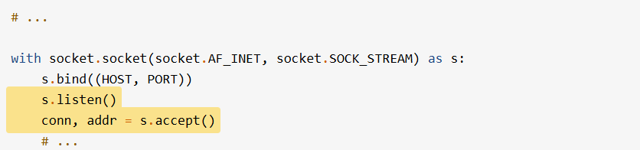
.listen()
In the server example, .listen() enables a server to accept connections. It makes the server a listening socket:
The .listen() method has a backlog parameter. It specifies the number of unaccepted connections that the system will allow before refusing new connections.
Starting in Python 3.5, it’s optional. If not specified, a default backlog value is chosen.

Slide 58
backlog
If your server receives a lot of connection requests simultaneously, increasing the backlog value may help by setting the maximum length of the queue for pending connections.
The maximum value is system dependent. For example, on Linux, see /proc/sys/net/core/somaxconn.

Slide 59
.accept()
The .accept() method blocks execution and waits for an incoming connection.
When a client connects, it returns a new socket object representing the connection and a tuple holding the address of the client.
The tuple will contain (host, port) for IPv4 connections or (host, port, flowinfo, scopeid) for IPv6.

Slide 60
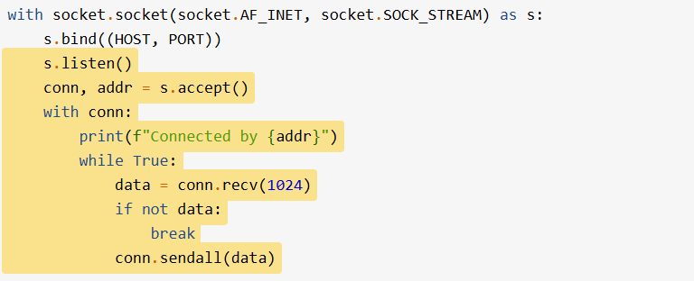
.accept()
you now have a new socket object from .accept(). It’s the socket that you’ll use to communicate with the client. It’s distinct from the listening socket that the server is using to accept new connections

Slide 61
connection object
After .accept() provides the client socket object conn, an infinite while loop is used to loop over blocking calls to conn.recv(). This reads whatever data the client sends and echoes it back using conn.sendall().
If conn.recv() returns an empty bytes object, b'', that signals that the client closed the connection and the loop is terminated. The with statement is used with conn to automatically close the socket at the end of the block.

Slide 62
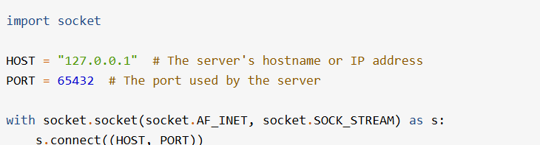
Client
It creates a socket object, uses .connect() to connect to the server and calls s.sendall() to send its message. Lastly, it calls s.recv() to read the server’s reply and then prints it.

Slide 63
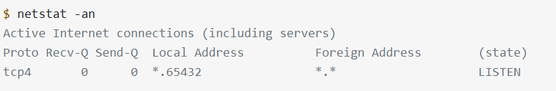
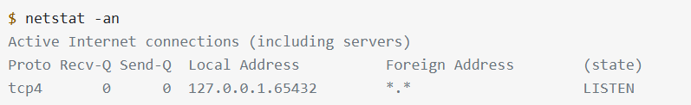
Viewing Socket State
To see the current state of sockets on your host, use netstat. It’s available by default on macOS, Linux, and Windows.
Notice that Local Address is 127.0.0.1.65432. If the server had used HOST = "" instead of HOST = "127.0.0.1", netstat would show this:

Slide 64
Local Address
Local Address is *.port, which means all available host interfaces that support the address family will be used to accept incoming connections.
In this example, socket.AF_INET was used (IPv4) in the call to socket(). You can see this in the Proto column: tcp4.

Slide 65
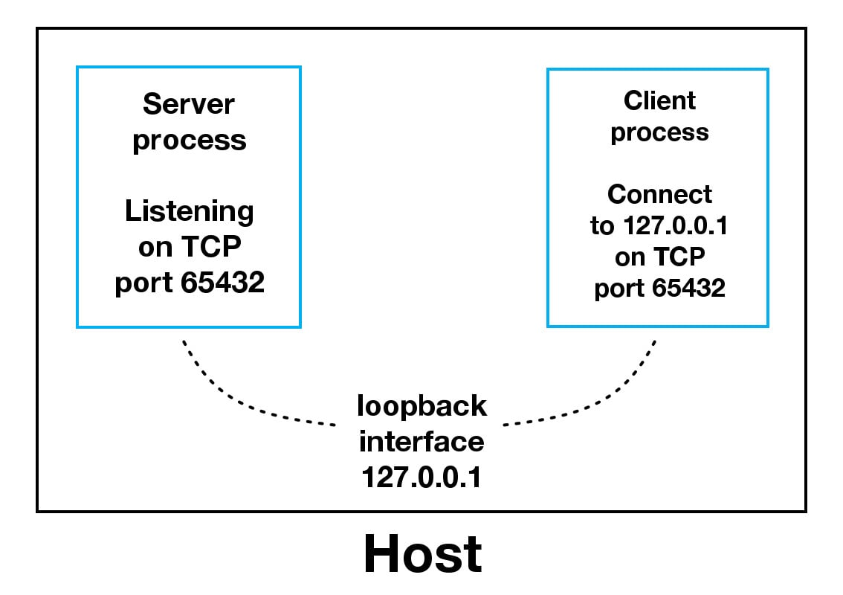
Communication Breakdown
When using the loopback interface (IPv4 address 127.0.0.1 or IPv6 address ::1), data never leaves the host or touches the external network.
In the diagram above, the loopback interface is contained inside the host. This represents the internal nature of the loopback interface and shows that connections and data that transit it are local to the host.

Slide 66
Loopback interface
Applications use the loopback interface to communicate with other processes running on the host and for security and isolation from the external network. Because it’s internal and accessible only from within the host, it’s not exposed.

Slide 67
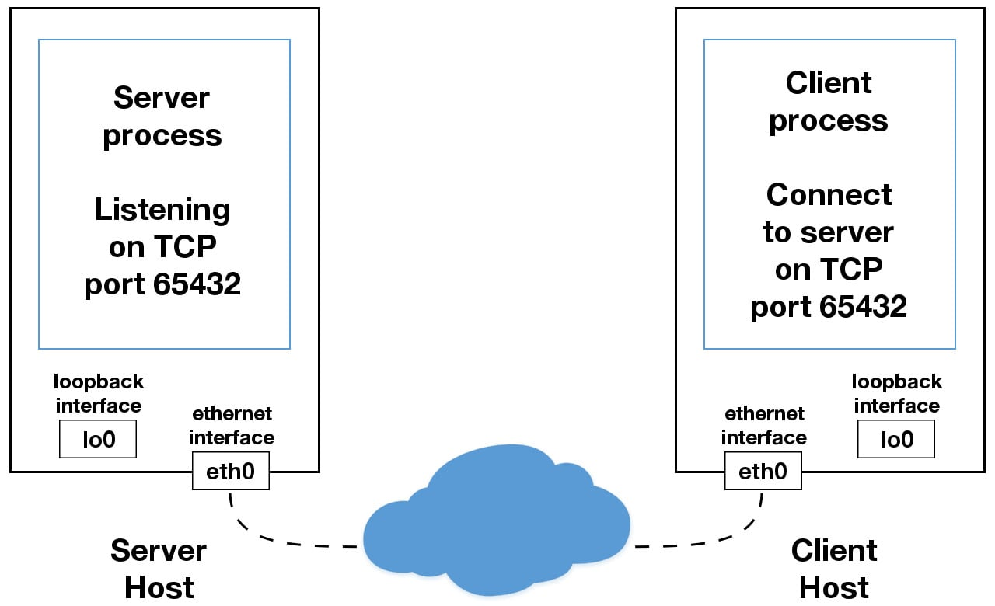
When you use an IP address other than 127.0.0.1 or ::1 in your applications, it’s probably bound to an Ethernet interface that’s connected to an external network. This is your gateway to other hosts outside of your “localhost” kingdom

Slide 68
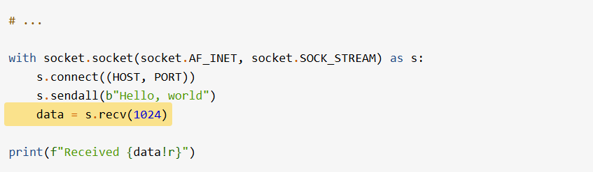
The bufsize argument of 1024 used above is the maximum amount of data to be received at once. It doesn’t mean that .recv() will return 1024 bytes.
The .send() method also behaves this way. It returns the number of bytes sent, which may be less than the size of the data passed in. You’re responsible for checking this and calling .send() as many times as needed to send all of the data

Slide 69
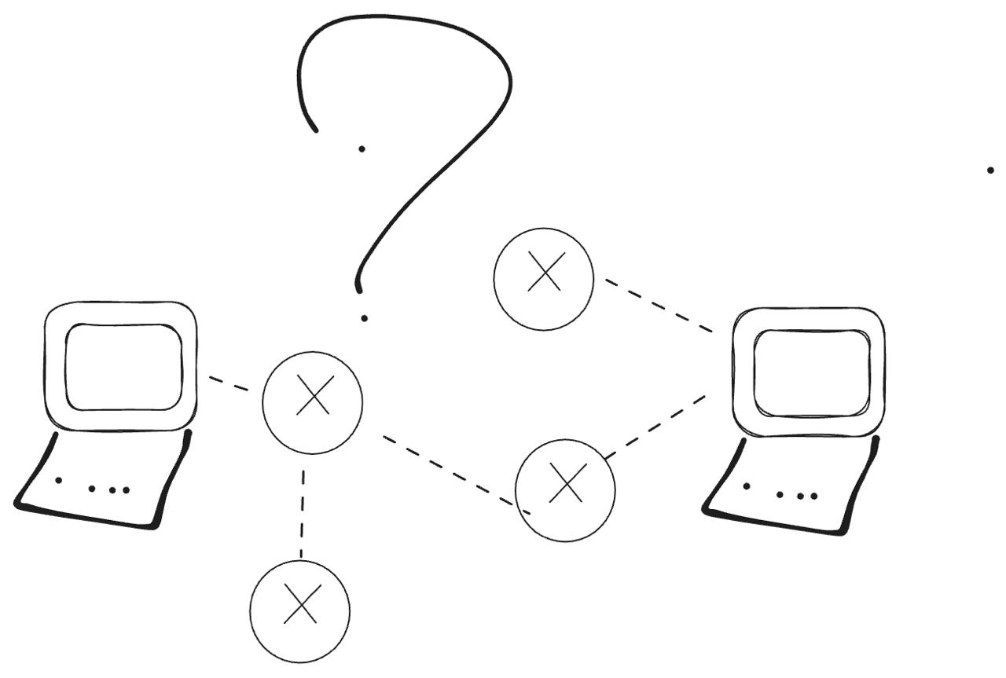
How does the Kernel handle TCP requests?

